Slide 1
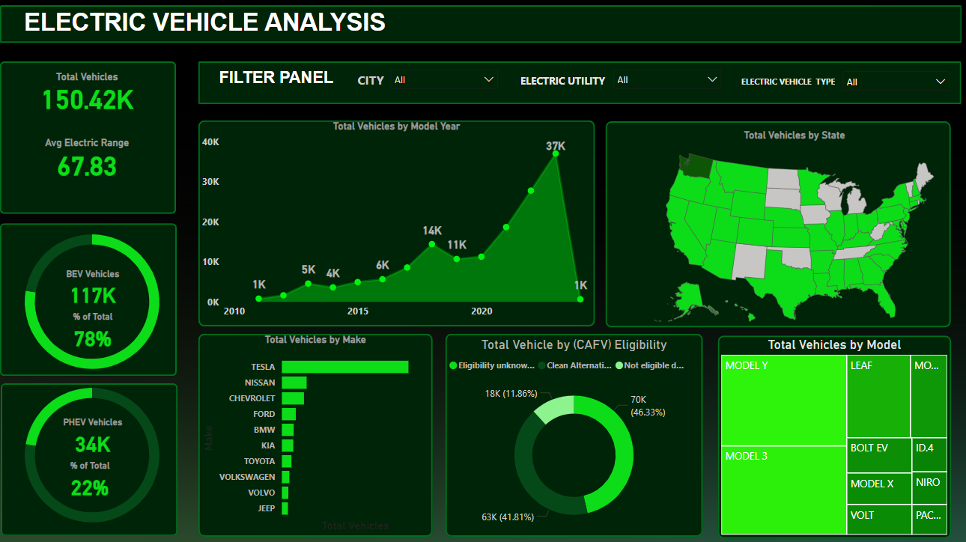
PROBLEM STATEMENT
KPI’S Requirement
Total Vehicles:
Understand the overall landscape of electric vehicles, encompassing both BEVs and PHEVs, to assess the market's size and growth.
2. Average Electric Range:
Determine the average electric range of the electric vehicles in the dataset to gauge the technological advancements and efficiency of the EVs.
3. Total BEV Vehicles and % of Total BEV Vehicles:
Identify and analyze the total number of Battery Electric Vehicles (BEVs) in the dataset.
Calculate the percentage of BEVs relative to the total number of electric vehicles, providing insights into the dominance of fully electric models.
4. Total PHEV Vehicles and % of Total PHEV Vehicles:
Identify and analyze the total number of Plug-in Hybrid Electric Vehicles (PHEVs) in the dataset.
Calculate the percentage of PHEVs relative to the total number of electric vehicles, offering insights into the market share of plug-in hybrid models.

Slide 2

PROBLEM STATEMENT
Charts Requirement
Total Vehicles by Model Year (From 2010 Onwards):
Visualization: Line/ Area Chart
Description: This chart will illustrate the distribution of electric vehicles over the years, starting from 2010, providing insights into the growth pattern and adoption trends.
2. Total Vehicles by State:
Visualization: Map Chart
Description: This chart will showcase the geographical distribution of electric vehicles across different states, allowing for the identification of regions with higher adoption rates.
3. Top 10 Total Vehicles by Make:
Visualization: Bar Chart
Description: Highlight the top 10 electric vehicle manufacturers based on the total number of vehicles, providing insights into the market dominance of specific brands.
4. Total Vehicles by CAFV Eligibility:
Visualization: Pie Chart or Donut Chart
Description: Illustrate the proportion of electric vehicles that are eligible for Clean Alternative Fuel Vehicle (CAFV) incentives, aiding in understanding the impact of incentives on vehicle adoption.
5. Top 10 Total Vehicles by Model:
Visualization: Tree map
Description: Highlight the top 10 electric vehicle models based on the total number of vehicles, offering insights into consumer preferences and popular models in the market.

Slide 3
KEY COLUMN
VIN (1-10): Vehicle Identification Number (first 10 characters).
County: The county of the vehicle's registration.
City: The city of the vehicle's registration.
State: The state of the vehicle's registration (all entries appear to be in Washington).
Postal Code: The postal code for the vehicle location.
Model Year: The manufacturing year of the vehicle.
Make: The manufacturer of the vehicle.
Model: The specific model of the vehicle.
Electric Vehicle Type: Whether it's a Battery Electric Vehicle (BEV) or Plug-in Hybrid Electric Vehicle (PHEV).
CAFV Eligibility: Eligibility status under Clean Alternative Fuel Vehicle policies.
Electric Range: The maximum range of the vehicle on electric power.
Base MSRP: Manufacturer's suggested retail price (baseline cost).
Legislative District: Associated legislative district.
Vehicle Location: Geographical coordinates of the vehicle.
Electric Utility: The electric utility provider for the area.
2020 Census Tract: Census data for geographic analysis.

Slide 4
PROJECT OBJECTIVE
Analyze and derive insights on electric vehicle adoption, distribution, and characteristics across various locations. Specific goals might include:
Understanding the adoption rate of EVs by region, type, or manufacturer.
Identifying trends in electric range and pricing.
Mapping EV distribution to legislative districts or utility providers.
Evaluating CAFV eligibility and its implications on EV adoption.

Slide 5
PROJECT INSIGHT
Adoption Trends:
Analyze which counties or cities have the highest adoption rates.
Explore trends by model year, make, or type of EV.
Range and Pricing:
Examine the relationship between electric range, vehicle type, and price.
Assess whether certain manufacturers dominate specific price or range categories.
Geographical Patterns:
Use location and legislative district data to map EV usage.
Identify patterns in regions served by different electric utilities.

